Slide 1

SC1015
Mini Project
Lab Group FCEB
Li Yujia (U2320574C) Balaji Abarnasri (U2321675E)
Chen RuiLin (U2321395K)
Notes:
Hello, everyone. Today we will present our mini-project. I’m Yujia, and here are my friends Abarnasri and Ruilin. We are from lab group FCEB.

Slide 2

Table of Contents
Introduction
01
Data Preparation and Cleaning
02
03
Exploratory Data Analysis
Machine Learning Techniques
04
Notes:
Here’s the sequence of our presentation. First let me introduce our project.

Slide 3

Introduction
Video Game Sales Dataset (Kaggle)
Which genre will earn more in the future?
1
How does the genre affect the sales among all countries?
2
How does the platform affect the sales?
3
How does the publisher affect the game sales?
Notes:
Our dataset is about video game sales. The main problem is which genre will earn more in the future. And below are the subproblems.

Slide 4
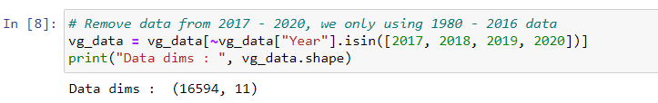
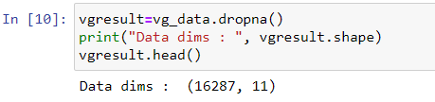
Data Preparation and Cleaning
Year
We remove years from 2017 - 2020
NA value
We remove the entries row that has contained NA value
Notes:
Before we start our data analysis, we do the data preparation and cleaning. We remove years from 2017 to 2020 because the data among this range is too little. Also, we remove the entries row that has contained NA value. On the right is our code.

Slide 5
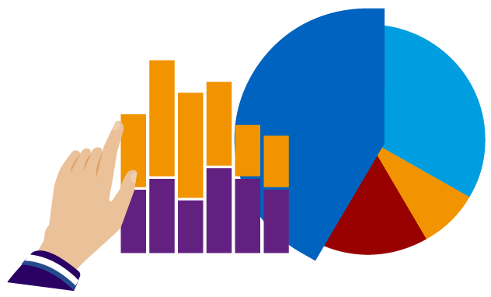

EXPLORATORY DATA ANALYSIS
Notes:
Now I will be talking about the exploratory analysis that we conducted on our data to answer our research questions

Slide 6
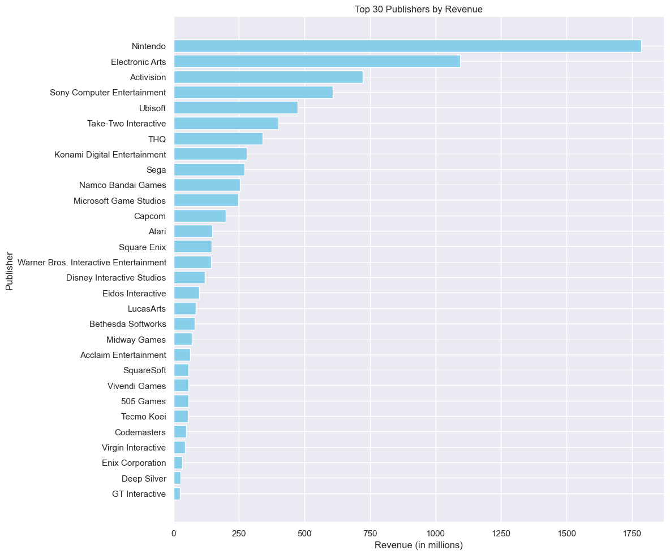
Top Publishers
TOP 5 PUBLISHERS FROM 1980 TO 2016:
Nintendo
Electronic Arts
Activision
Sony Computer Entertainment
Ubisoft
Notes:
First, we calculated the total global sales by each publisher from 1980 to 2016 to compare the top publishers by the total revenue they earned over the years. From the bar graph we can see that the top 5 publishers are Nintendo, Electronic Arts, Activision, Sony Computer Entertainment and Ubisoft.

Slide 7
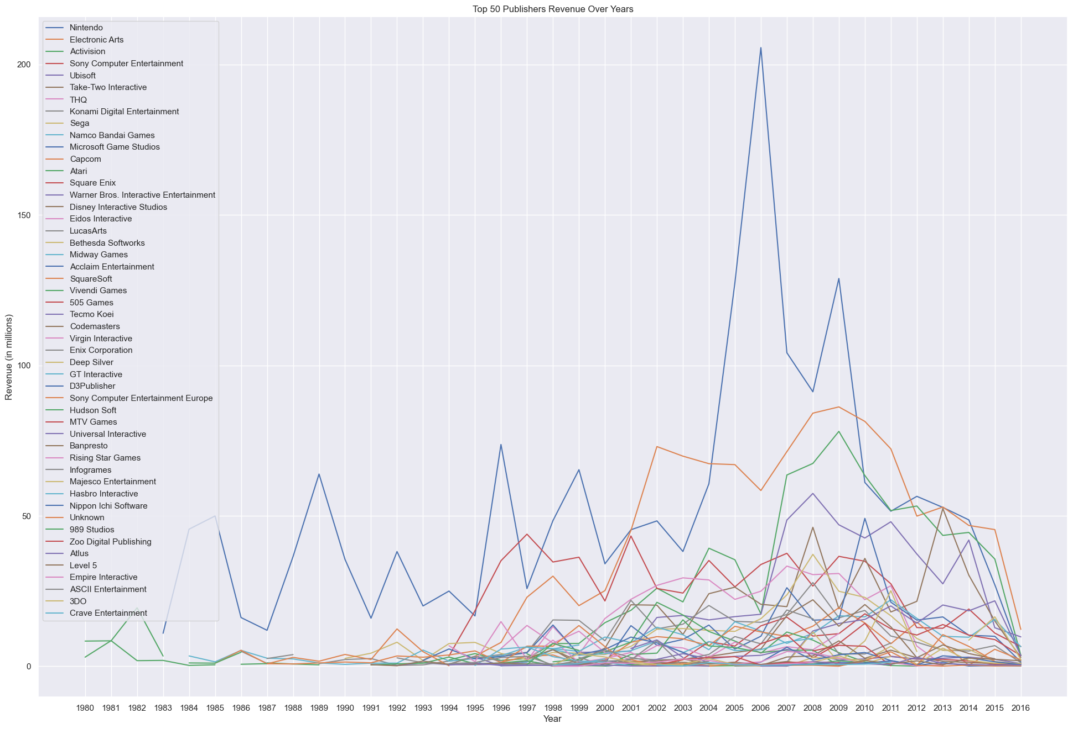
Top 50 Publishers Revenue Over Time
Generally increasing trend
Notes:
As just comparing the total revenue over the entire time frame does not account for the revenue earned by newer companies we plotted a line graph to show the top 50 publishers revenue over time. There is a generally increasing trend in the revenue for all publishers. However, we noted that nintendo’s growth was the most interesting as it is the top publisher and it has the most fluctuations in its revenue over time.

Slide 8
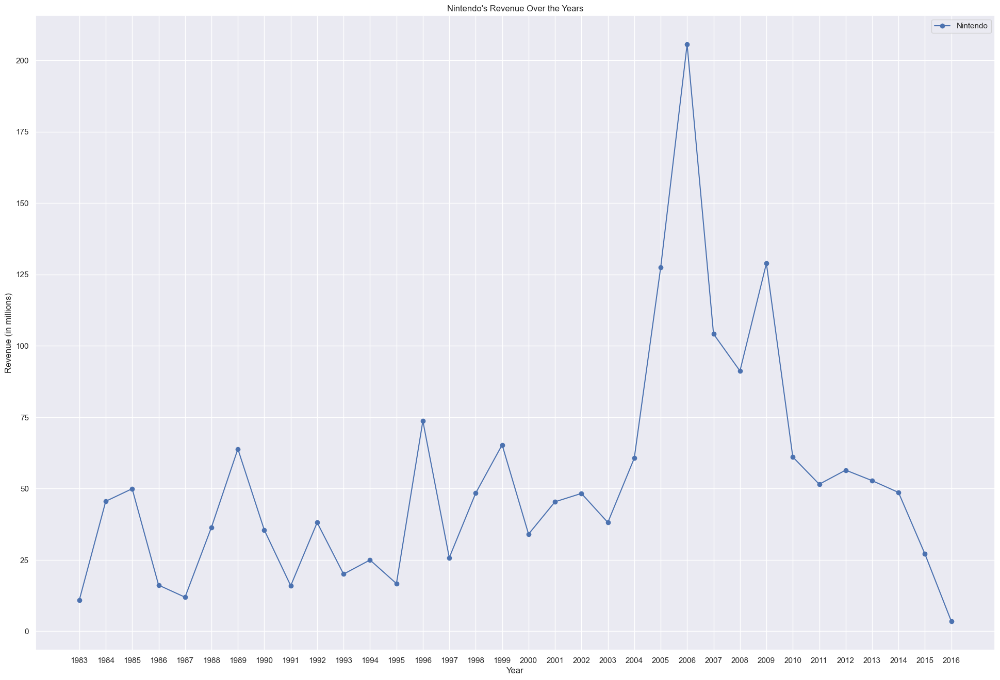
Top 50 Publishers Revenue Over Time
Highest-earning publisher: Nintendo
sharp increase in 2006 due to the success of the nintendo 3DS and wii as ‘both the DS and Wii focus on intuitive, easy-to-play games’ (Reuters, 2006) which catered to the general population
sharp decrease from 2012 onwards as the wii-u release was generally not well received
Notes:
Through extracting just nintendo’s revenue earner over time we can observe a sharp increase in 2006 and a drop after that. The sharp increase in 2006 is due to the success of the nintendo 3DS and wii as ‘both the DS and Wii focus on intuitive, easy-to-play games’ which catered to the general population. The decrease especially from 2012 onwards was due to the release of the wii-u which was not popular and generally not well received.

Slide 9
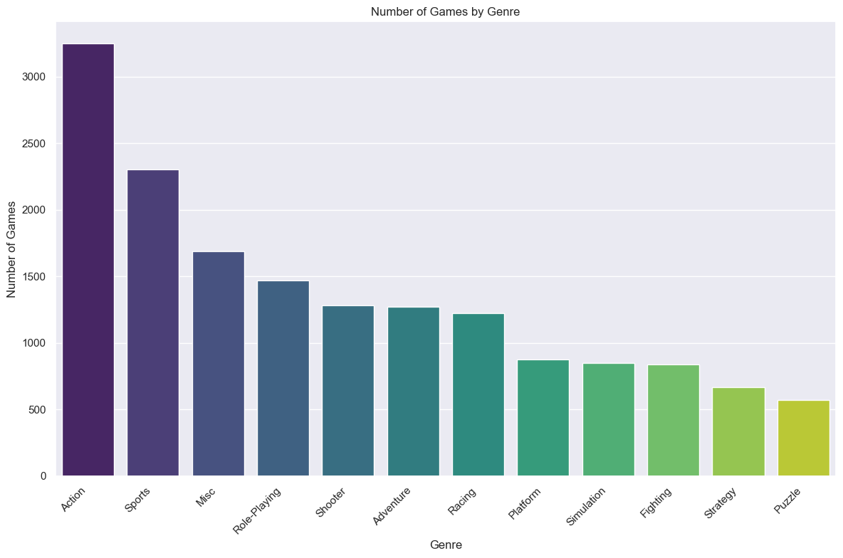
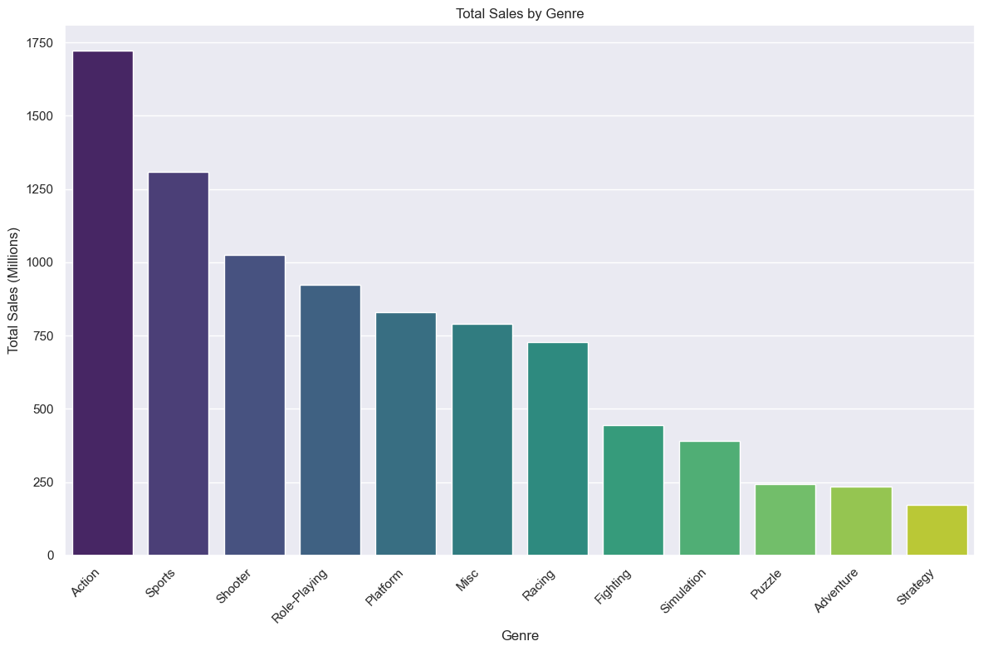
Total Games Per Genre Vs Total Revenue Per Genre
despite the fewer number of shooter and platform games, they generate more revenue
Notes:
As our focus is on which genre will be more successful in the future, we compared the total games to genre and the total revenue earned by each genre. Despite shooter and platform having fewer games that sports, miscellaneous and adventure they generate more revenue so it suggests that these genre of games are more popular and successful

Slide 10
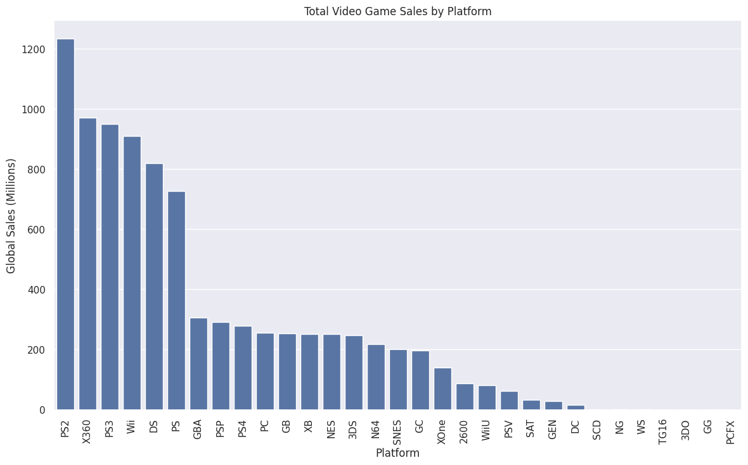
Total game sales from different platform
PS2 has the most sales
Notes:
We also compared the total game sales to the various platforms to see if they played a major role in influencing game sales. PS2 had the most sales.

Slide 11
Machine Learning Techniques
Naive Bayes Classification
Random Forest Classification
Linear Regression
Decision Tree Classification
Clustering
Notes:
Next we used a few machine learning techniques such as Naive Bayes classification, linear regression, clustering, decision tree classification and random forest classification

Slide 12

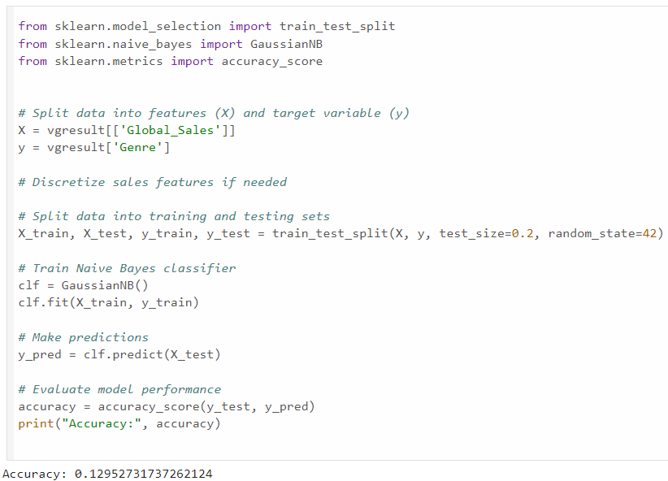
Naive Bayes Classification
Using Naive Bayes for classification involves assuming independence between features and then applying Bayes' theorem.
An accuracy of 0.129527 means that only 12.95% of the instances in our test data correctly predicted the genre.
Notes:
First, we used Naive Bayes for classification which involves assuming independence between features and then applying Bayes' theorem. However we only got an accuracy of 0.12957 which means that only 12.95% of the instances in our test data correctly predicted. This is because, in the case of predicting genre based on sales, assuming independence might not be appropriate since sales figures are likely correlated with genre.

Slide 13
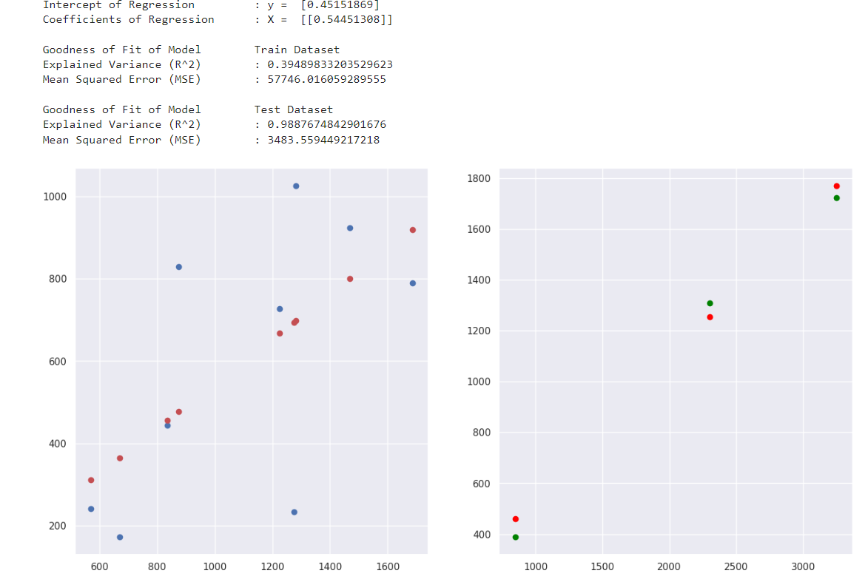
Linear Regression
Train Dataset
Test Dataset
Regression
Intercept y = 0.452
Coefficients: x = 0.545
Train Dataset
Explained Variance (R^2): 39%
Mean Squared Error(MSE): 57746.02
Test Dataset
Explained Variance (R^2): 99%
Mean Squared Error(MSE): 3483.59
Notes:
As a result, we used a Linear Regression model to determine the relationship between the "total count" and "total sales" in each genre. Before we proceed, we split the data into 2 parts: 80% of the data for the training and 20% for testing. We also set a random seed for reproducibility to ensure that the split is consistent each time we execute the code. This model has coefficients of 0.545, indicating a positive relationship between these 2 variables. This means that when the total count increases, the total sale will also increase. The model’s goodness of fit on the train data is around 39%, with a mean square error (MSE) of 57746.02. After applying this model to the test dataset, R square has increased to 99%, while mean square error (MSE) fall to 3483.59. This suggests that the model perform well on unseen data. However, there may be some overfitting due to the greater difference in R square between the train and test datasets.

Slide 14
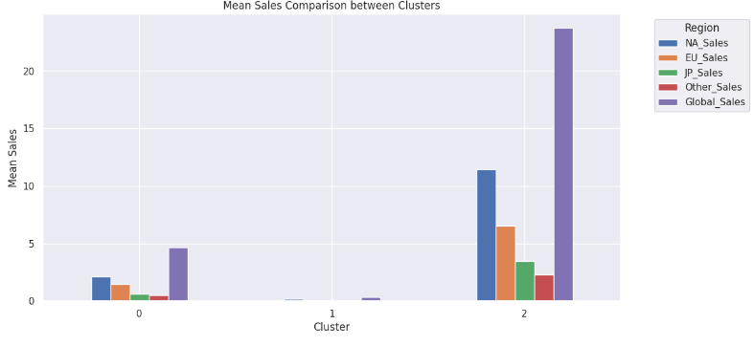
Clustering
3 Cluster
0. lowest Sales
1. Middle Sales
2. Highest Sales
We use clustering to group similar data point together base on sales to see which genre has the highest total sales
Cluster 2
Sport
Platform
Racing
Role playing
Puzzle
Misc
Shooter
Simulation
Action
Notes:
After conducting Linear Regression analysis on the relationship between video game genres and sales, we observed a significant correlation. To go deeper into the data and find possible trends, we choose to use a clustering model to group similar genres based on their sales performance to provide valuable insights for further analysis. This model will use k-means clustering with 3 clusters, the lowest, medium, and highest sales, to the normalised data. This will group the data points into 3 clusters based on their sales patterns across different regions. Furthermore, it will assign the cluster labels to each data point in the data frame. We can see that cluster 2 has the highest mean global sales, and it includes Sport, Platform, Racing, Role Playing, Puzzle, Misc, Shooter, Simulation, and Action. These are the genres that tend to perform well in terms of global sales.

Slide 15
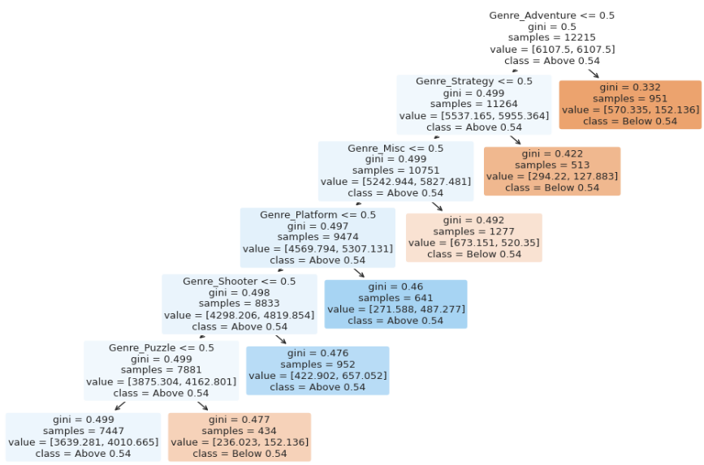
Decision Tree Classification
Classes
1. Above 0.54
2. Below 0.54
We use decision tree to classify which genre has total sales that is above 0.54 and below 0.54.
Notes:
Next, we use the decision tree classification to predict which genres are likely to have global sales that are above and below 0.54. The dataset produced a mean global sales value of 0.54.

Slide 16
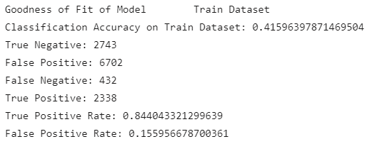
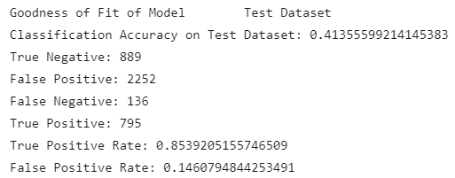
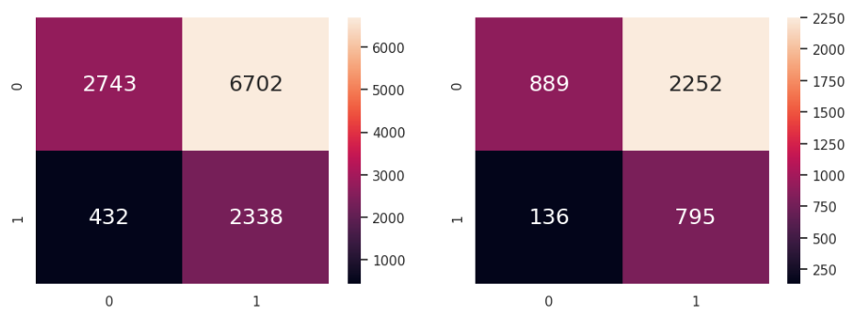
Decision Tree Classification
The dataset was imbalance
class_weight = balance
To adjusts the weights inversely proportional to class frequencies (below 0.54) in the data
Focuses more on the minority class (Above 0.54)
Accuracy
Train Dataset: 42%
Test Dataset: 41%
Notes:
Due to the overfitting that we have discovered in the Linear Regression model, we set the class weight to balance to solve the imbalance dataset in this model by adjusting the weight inversely proportional to class frequencies, which is below 0.54 in this dataset, allowing us to focus more on the above 0.54. The classification accuracy on the train and test datasets was around 42%, indicating that this classification was not effective in predicting global sales above and below 0.54. However, it has a high true positive rate of around 85% in both the train and test datasets, which means that the model can accurately identify 85% of all the actual positives as above 0.54.

Slide 17
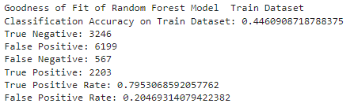
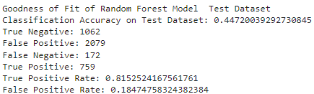
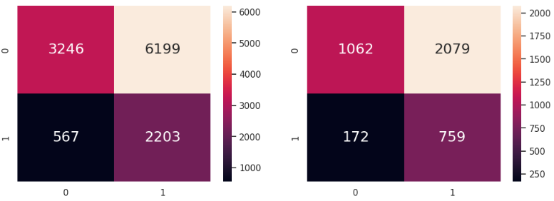
Random Forest Classification
We uses the Random Forest to verify with our accuracy of the model
Accuracy
Train Dataset: 45%
Test Dataset: 45%
Notes:
To verify the accuracy of the model, we used the random forest classification. The classification accuracy of both training and testing datasets has significantly increased to 45%, making prediction more accurate.

Slide 18
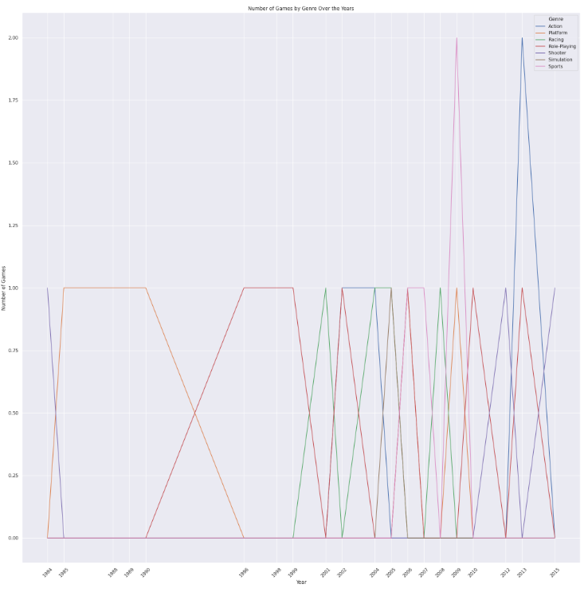
Predicted Genre Vs Year
Total Genre in both True Positive and in Cluster 2:
Role-Playing: 7
Platform: 6
Sports: 4
Racing: 4
Action: 4
Shooter: 3
Simulation: 1
Role Playing
It has constantly had high sales over the year
Notes:
We next plot the data in the true positive that the random forest predicted accurately as well as in cluster 2, which we evaluated in the clustering model, against the year. This graph shows the total number of games released per genre over the year. From the graph, we can see that role-playing has constantly had high sales throughout the year. As a result, it has the highest chance of earning more sales in the future.

Slide 19

New Insights
Naive Bayes classification
Involves assuming independence between features
However, for predicting genre based on sales, assuming independence might not be appropriate since sales figures are likely correlated with genre.
Handling imbalanced dataset
By setting the class weight to balance
Too many data below 0.54 causes data to be biased below 0.54
Notes:
Here is what we have learnt in this mini-project.

Slide 20
New Insights
Clustering
Use clustering to group similar data point together base on sales to see which genre has the highest total sales
Segment large datasets into smaller, more manageable groups.

Slide 21
Conclusion
Process: Data Preparation and Cleaning -> Exploratory Data Analysis -> Machine Learning Techniques
The results of the problems:
Which genre will earn more in the future
Role Playing
How does the genre affect the sales among all countries?
Rank: Action, Sports, Misc
How does the platform affect the sales?
Rank: PS2, X360, PS3
How does the publisher affect the game sales?
Rank: Nintendo, Electronic, Arts Activision
Notes:
Here is our conclusion. The project focused on analyzing video game sales data. Key points highlighted include understanding the impact of genre, platform, and publisher on sales. The objective is to predict which genre will earn more in the future.

Slide 22
Reference
Video Game Sales dataset from [Kaggle] Accessed in 2024. https://www.kaggle.com/datasets/gregorut/videogamesales
Reuters. (2007, August 10). Nintendo 2006/07 profit jumps, sees further growth. https://www.reuters.com/article/idUST291144/
Geeksforgeeks. (2024, Mar 01). Naive Bayes Classifiers https://www.geeksforgeeks.org/naive-bayes-classifiers/
Geeksforgeeks. (2024, Mar 20). Clustering in Machine Learning https://www.geeksforgeeks.org/clustering-in-machine-learning/
Scikit Learn. (n.d). 2.3. Clustering https://scikit-learn.org/stable/modules/clustering.html

Slide 23

THANK
You
github.com/RuiLinnnn/SC1015-Project-Video-Game

